Slide 1
Lighting for Computer Graphics
CAS 741 | Sasha Soraine

Slide 2
Problem Statement
Understand how light interacts with objects with different material properties and model it for virtual environments.
Words to know:
Computer graphics
Virtual environment
Material Properties

Slide 3
Binding Time: Scope
Understand and model geometrical optics simulation of light interacting with material objects.
Optics
Geometrical Optics
Wave Optics
Words to know:
Geometrical Optics
Rays

Slide 4
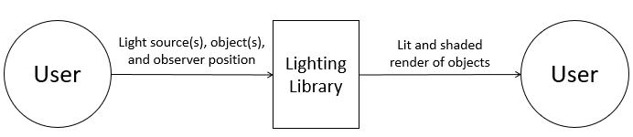

Slide 5
Goal Statements
Given some light source(s), some object(s), and an observer:
GS1: Generate a fully lit and shaded scene of the object(s) based on the observer location and positions and material properties of the object(s).
GS2: Predict the light ray(s) reflected from the object(s) to the observer.
GS3: Calculate the vectors for light ray(s) reflected off the object(s) based on light source(s).
GS4: Calculate the shading for different parts of the object based on light source(s) and observer positions.

Slide 6
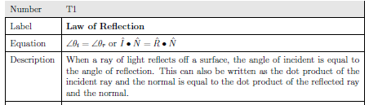
Theoretical Models

Slide 7
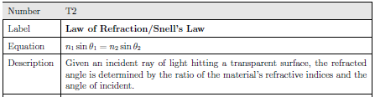
Theoretical Models

Slide 8
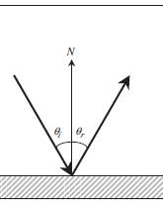
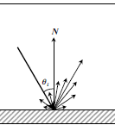
General Definitions
Specular Reflection
Diffuse Reflection
Notes:
Should these be general definitions or are these theoretical models?
They both are the law of reflection, but they become relevant in shading based on material properties.

Slide 9
Variabilities to Consider
Object
Material properties
refractive index of object
how shiny/glossy it is
Light source
Type of light source (ambient, point, spotlight, directional, etc.)
Number of light sources

Slide 10
Assumptions to simplify the problem
A1: All objects are opaque.
No refraction.
Can’t handle modeling water or glass.
Notes:
This simplifies everything to simple reflection problems. This is a common assumption in computer graphics as modeling water or glass in a photorealistic way is complicated and time consuming.

Slide 11
Related Likely Changes
LC1: Objects can be transparent.
Incorporates refraction.
Can handle modeling water or glass.
Notes:
This simplifies everything to simple reflection problems. This is a common assumption in computer graphics as modeling water or glass in a photorealistic way is complicated and time consuming.

Slide 12
Variabilities to Consider (Redux)
Object
Mesh complexity
Material properties
refractive index of object
how shiny/glossy it is
Light source
Type of light source (ambient, point, spotlight, directional, etc.)
Number of light sources
Interpolation Technique
By vertex, by mesh geometry, continuous
Reflection Model
Notes:
Should interpolation technique and reflection model be variations in input? I’ve left them for the binding time to be at run time because I think it would be most robust/useful that way.
This may change depending on project.

Slide 13
Variabilities to Consider (Input and Output)
Input can be given by:
Separate files with list of light sources, objects, and observer and their respective properties.
Function call.
Output can be given:
Code that generates the image.
Screen with rendered scene.
Notes:
Should interpolation technique and reflection model be variations in input?

